Slide 1
EC 544 Challenge 1 Building A Nest
Group 07
Xiangtian Yi, Shisheng Wang, Ye Xing, Yanlin Zhou

Slide 2


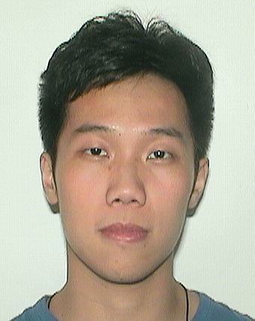

Presenter on this challenge, and to date
 | Xiangtian | Shisheng | Ye | Yanlin
Challenge 1 | Presenter
Challenge 2 |  | Presenter
Challenge 3 |  |  | Presenter
Challenge 4 |  |  |  | Presenter
Challenge 5 | Presenter
Challenge 6 |  | Presenter
Challenge 7 |  |  | Presenter
Challenge 8 |  |  |  | Presenter
Notes:
Photos from sports.yahoo.com

Slide 3
 | Xiangtian | Shisheng | Ye | Yanlin
1 | I worked on the web configuration. Node.js coding and checked correctness of temperature data. Arduino testing and configuration. | Found the schematic online, connected all the components together on the board and Tested analog ports to make sure those could work. | I worked on the Arduino software part. My portion of this consisted of searching google for the equation to get the temperature and translating it to the Arduino code. And also participate into the test of project. | I implemented the Xbee chat part. I followed the guide online to set up the devices and realized the communication between Xbees.
Notes:
Photos from sports.yahoo.com

Slide 4
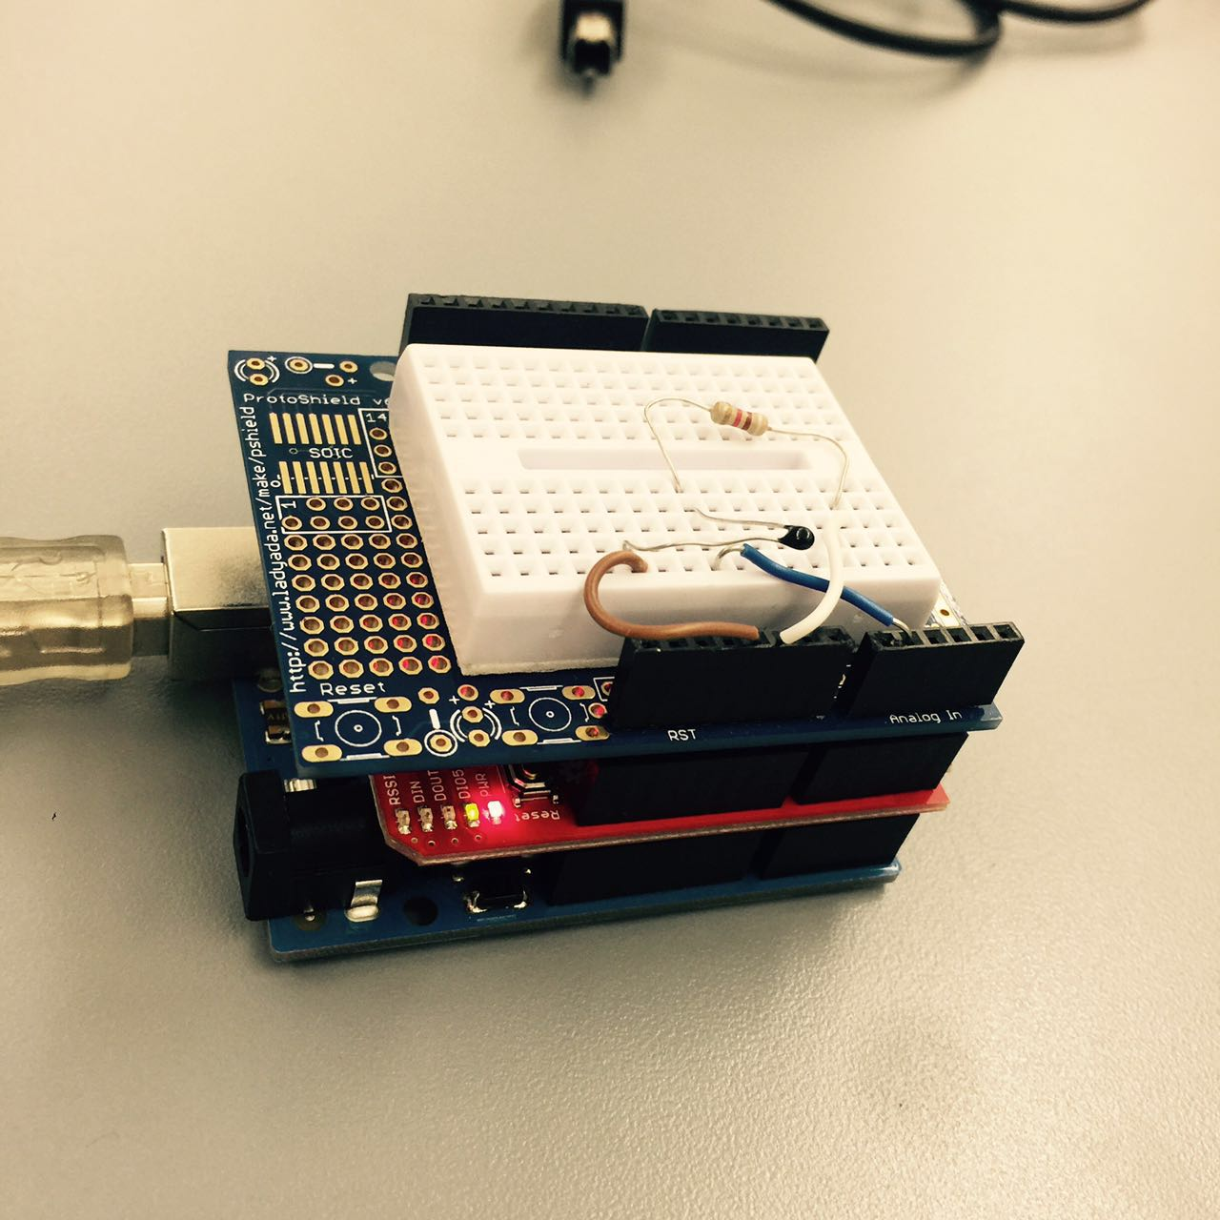
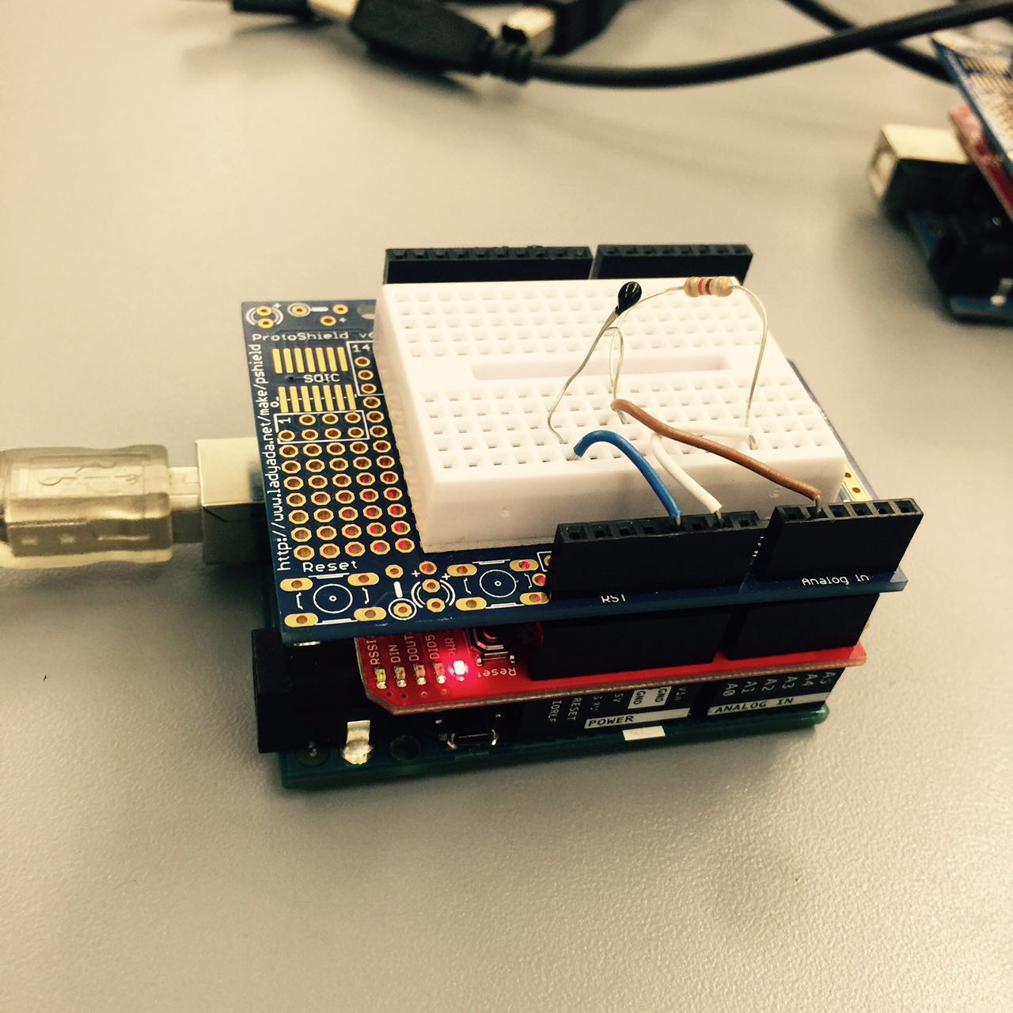
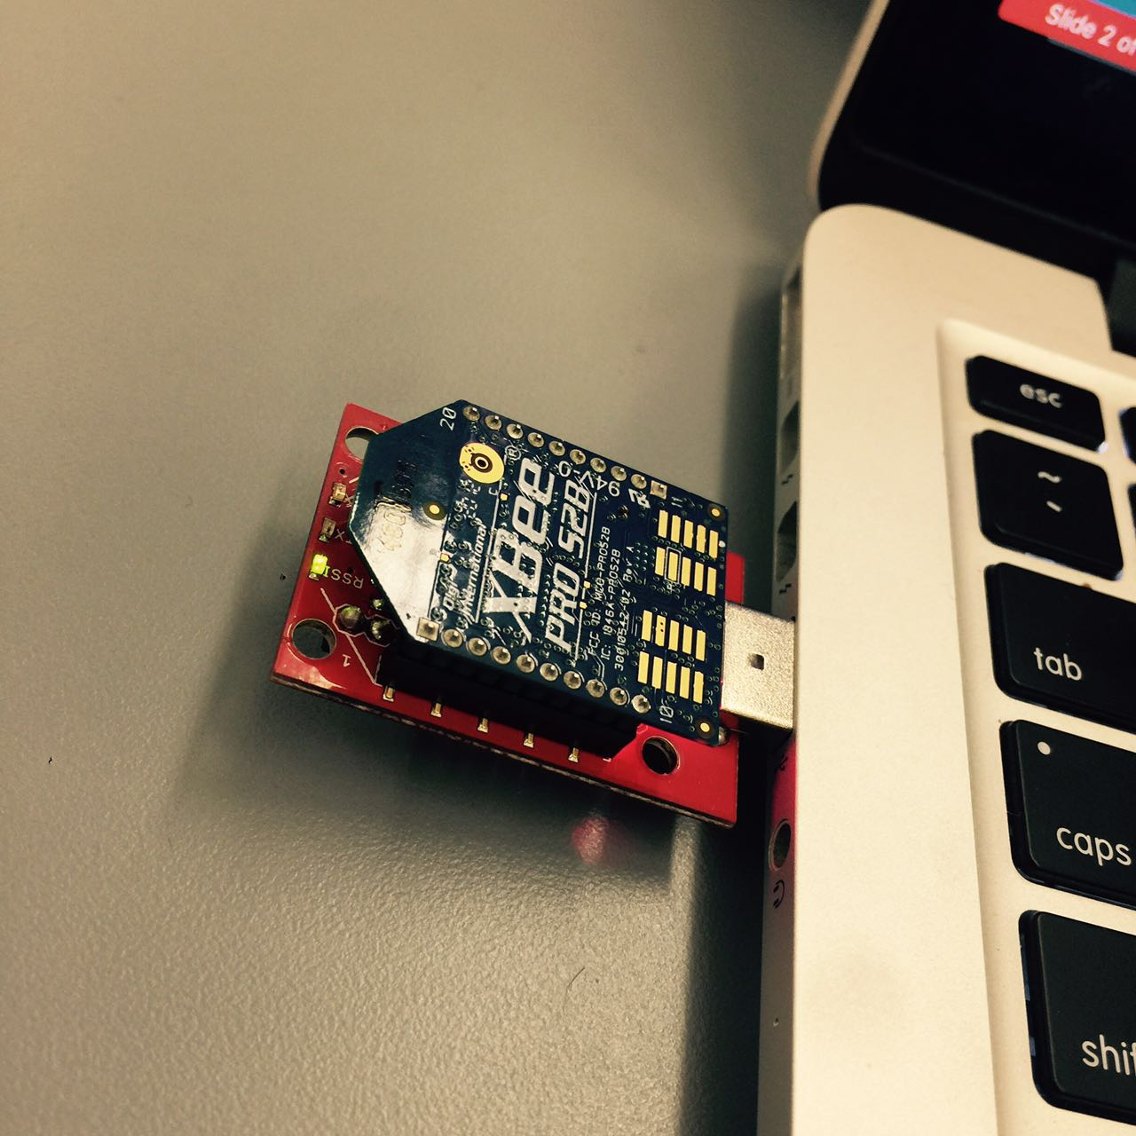
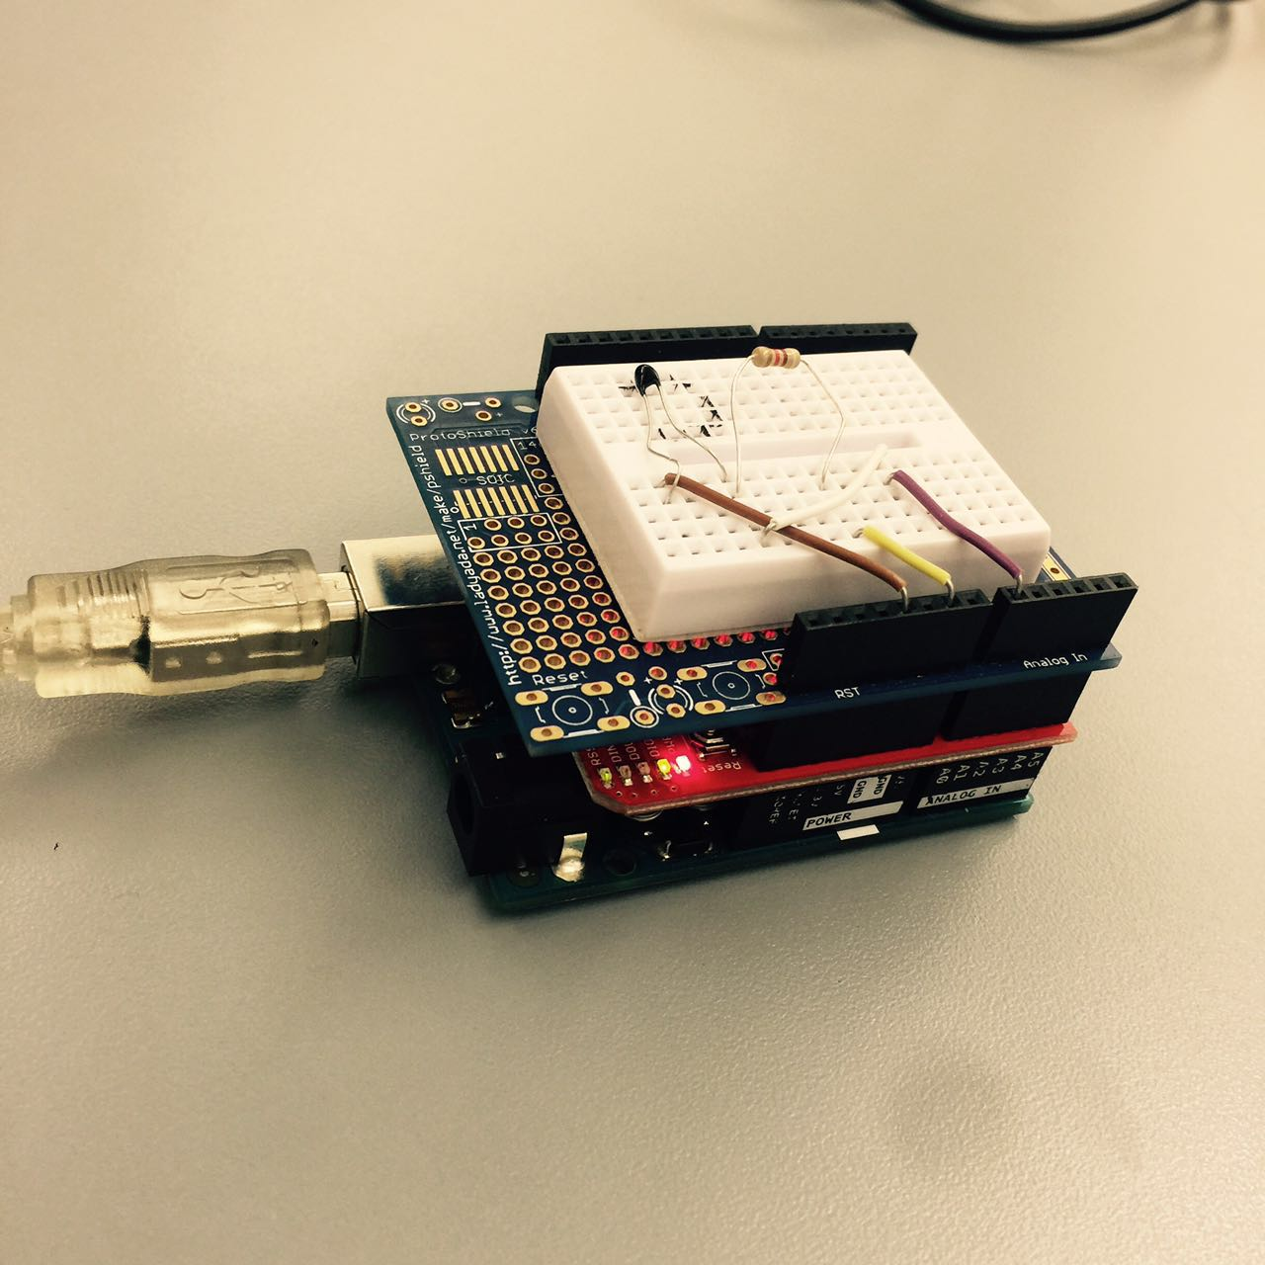
Design Concept
Coordinator:
Calculating the average of 3 temperatures from 3 sensors
Router 2
Router 1
Every sensor sends temperature every 2 second. And the coordinator would obtain the average temperature immediately.
Router 3

Slide 5
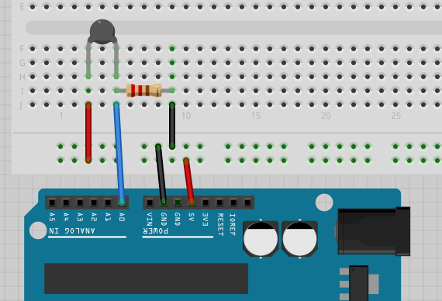
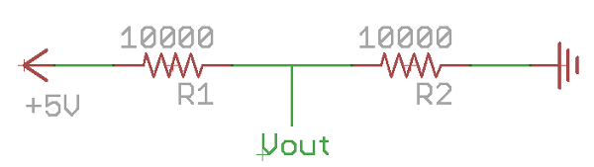
Voltage Divider Circuit
Sample Breadboard Wiring
Ref: https://computers.tutsplus.com/tutorials/how-to-read-temperatures-with-arduino--mac-53714

Slide 6
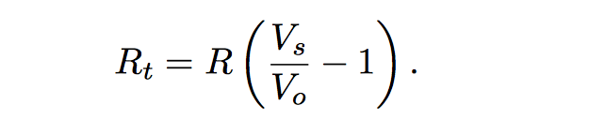
(1) Computing Thermistor Resistance
(2) Steinhart-Hart Equation
Ref: https://en.wikipedia.org/wiki/Steinhart%E2%80%93Hart_equation
where R = 10kohm
T = Temperature in Celsius
C1= 0.001129148
C2 = 0.000234125
C3 = 8.76741E-08

Slide 7
Challenges Encountered and Resolved
The malfunction of some analog ports led to errors. Serial monitor presented unexpected result.
Different baud rate led to error.
Cannot find the port of 3rd Party Arduino Board.
Code Optimization to improve quality and efficiency

